Slide 1
Improving Python and Spark Performance and Interoperability with Apache Arrow
Julien Le Dem
Principal Architect
Dremio
Li Jin
Software Engineer
Two Sigma Investments

Slide 2
About Us
Li Jin
@icexelloss
Julien Le Dem
@J_
Software Engineer at Two Sigma Investments
Building a python-based analytics platform with PySpark
Other open source projects:
Flint: A Time Series Library on Spark
Cook: A Fair Share Scheduler on Mesos
Architect at @DremioHQ
Formerly Tech Lead at Twitter on Data Platforms
Creator of Parquet
Apache member
Apache PMCs: Arrow, Kudu, Incubator, Pig, Parquet
Notes:
We are a quantitative hedge fund based in New York City

Slide 3
Agenda
Current state and limitations of PySpark UDFs
Apache Arrow overview
Improvements realized
Future roadmap

Slide 4
Current state and limitations of PySpark UDFs

Slide 5
Why do we need User Defined Functions?
Some computation is more easily expressed with Python than Spark built-in functions.
Examples:
weighted mean
weighted correlation
exponential moving average
Notes:
Spark build-in functions overs basic math opeartors and functions, such as ‘mean’, ‘stddev’, ‘sum’

Slide 6
What is PySpark UDF
PySpark UDF is a user defined function executed in Python runtime.
Two types:
Row UDF:
lambda x: x + 1
lambda date1, date2: (date1 - date2).years
Group UDF (subject of this presentation):
lambda values: np.mean(np.array(values))
Notes:
This is in comparison with build-in spark functions such as mean and sum where the python code gets translated into java code and executed in JVM
Grouped based udf doesn’t exist now.
Not sure about calling: lambda values: np.mean(np.array(values)) “grouped based udf”

Slide 7
Row UDF
Operates on a row by row basis
Similar to `map` operator
Example …
df.withColumn(
‘v2’,
udf(lambda x: x+1, DoubleType())(df.v1)
)
Performance:
60x slower than build-in functions for simple case
Notes:
60x is computed by:
T1 = df.agg(F.sum(df.v1))
T2 = df.withColumn(‘v2’, when(df.v1 > 0, 1.0).otherwise(-1.0)).agg(F.sum(‘v2’)
T3 = df.withColumn(‘v3’, F.udf(lambda x: 1.0 if x > 0 else -1.0, DoubleType())(df.v1)).agg(F.sum(“v3”))
(T3 – T1) / (T2 – T1)

Slide 8
Group UDF
UDF that operates on more than one row
Similar to `groupBy` followed by `map` operator
Example:
Compute weighted mean by month
Notes:
Grouping here can be by some id, category, or time based grouping, daily average

Slide 9
Group UDF
Not supported out of box:
Need boiler plate code to pack/unpack multiple rows into a nested row
Poor performance
Groups are materialized and then converted to Python data structures
Notes:
Groups are materialized is one of the performance issue. However, this is not the one we focus on here.
For instance, groupBy().agg(collect_list()) fully materialized the group. It takes about 1.5 seconds to do that, while the normalization examples takes more than 25 seconds

Slide 10
Example: Data Normalization
(values – values.mean()) / values.std()
Notes:
Groups are materialized is one of the performance issue. However, this is not the one we focus on here.
For instance, groupBy().agg(collect_list()) fully materialized the group. It takes about 1.5 seconds to do that, while the normalization examples takes more than 25 seconds

Slide 11
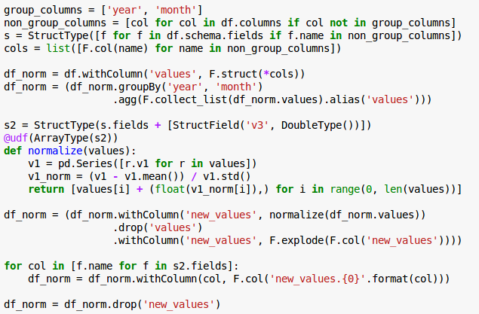
Example: Data Normalization
Notes:
(complicated code. Audience should not read the code. The presenter shows the boiler plate code vs actually code. The point here is show audience how difficult it is to do such things)

Slide 12
Example: Monthly Data Normalization
Useful bits
Notes:
(complicated code. Audience should not read the code. The presenter shows the boiler plate code vs actually code. The point here is show audience how difficult it is to do such things)

Slide 13
Example: Monthly Data Normalization
Boilerplate
Boilerplate
Notes:
(complicated code. Audience should not read the code. The presenter shows the boiler plate code vs actually code. The point here is show audience how difficult it is to do such things)

Slide 14
Example: Monthly Data Normalization
Poor performance - 16x slower than baseline
groupBy().agg(collect_list())

Slide 15
Problems
Packing / unpacking nested rows
Inefficient data movement (Serialization / Deserialization)
Scalar computation model: object boxing and interpreter overhead

Slide 16
Apache Arrow

Slide 17
Arrow: An open source standard
Calcite
Cassandra
Deeplearning4j
Drill
Hadoop
HBase
Ibis
Impala
Kudu
Pandas
Parquet
Phoenix
Spark
Storm
R
Common need for in memory columnar
Building on the success of Parquet.
Top-level Apache project
Standard from the start
Developers from 13+ major open source projects involved
Benefits:
Share the effort
Create an ecosystem

Slide 18
Arrow goals
Well-documented and cross language compatible
Designed to take advantage of modern CPU
Embeddable
In execution engines, storage layers, etc.
Interoperable

Slide 19
High Performance Sharing & Interchange
Before
With Arrow
Each system has its own internal memory format
70-80% CPU wasted on serialization and deserialization
Functionality duplication and unnecessary conversions
All systems utilize the same memory format
No overhead for cross-system communication
Projects can share functionality (eg: Parquet-to-Arrow reader)

Slide 20
Columnar data
persons = [{
name: ’Joe',
age: 18,
phones: [
‘555-111-1111’,
‘555-222-2222’
]
}, {
name: ’Jack',
age: 37,
phones: [ ‘555-333-3333’ ]
}]

Slide 21
Record Batch Construction
Schema Negotiation
data header (describes offsets into data)
{
name: ’Joe',
age: 18,
phones: [
‘555-111-1111’,
‘555-222-2222’
]
}
Dictionary Batch
name (bitmap)
name (offset)
name (data)
age (bitmap)
Record Batch
age (data)
phones (bitmap)
Record Batch
phones (list offset)
phones (offset)
Record Batch
phones (data)
Each box (vector) is contiguous memory
The entire record batch is contiguous on wire

Slide 22
In memory columnar format for speed
Maximize CPU throughput
Pipelining
SIMD
cache locality
Scatter/gather I/O
Notes:
Scatter/gather I/O also unknown as vectored I/O is the a method where single procedure call reads data from a stream and write to multiple buffers

Slide 23
Results
- PySpark Integration:
53x speedup (IBM spark work on SPARK-13534)
http://s.apache.org/arrowresult1
- Streaming Arrow Performance
7.75GB/s data movement
http://s.apache.org/arrowresult2
- Arrow Parquet C++ Integration
4GB/s reads
http://s.apache.org/arrowresult3
- Pandas Integration
9.71GB/s
http://s.apache.org/arrowresult4

Slide 24
Arrow Releases

Slide 25
Improvements to PySpark with Arrow

Slide 26
How PySpark UDF works
Batched Rows
Executor
Python
Worker
UDF: scalar -> scalar
Batched Rows

Slide 27
Current Issues with UDF
Serialize / Deserialize in Python
Scalar computation model (Python for loop)

Slide 28
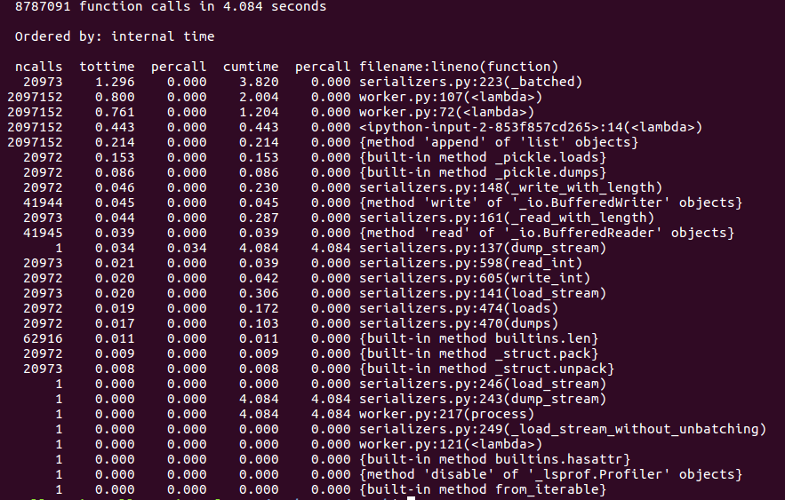
Profile lambda x: x+1
Actual Runtime is 2s without profiling.
8 Mb/s
91.8%
Notes:
To illustrate further, here is the profiling result of python worker during one UDF evaluation.
Without profiling, It took about 2 seconds to process 2M doubles. And most of the time is spent in serialization and udf evalution

Slide 29
Vectorize Row UDF
Rows -> RB
Executor
Python
Worker
UDF: pd.DataFrame -> pd.DataFrame
RB -> Rows
Notes:
So we made some changes to the PySpark

Slide 30
Why pandas.DataFrame
Fast, feature-rich, widely used by Python users
Already exists in PySpark (toPandas)
Compatible with popular Python libraries:
NumPy, StatsModels, SciPy, scikit-learn…
Zero copy to/from Arrow

Slide 31
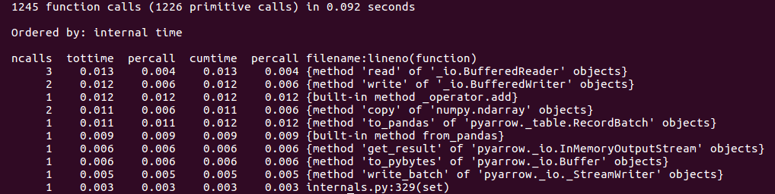
Scalar vs Vectorized UDF
Actual Runtime is 2s without profiling
20x Speed Up
Notes:
Note: Without profile, 4 seconds -> 2 seconds
Let’s now compare Scalar vs Vectorized UDF. For 2 M doubles, the runtime of the python worker goes from 2 seconds to about 0.14 seconds, that’s a 15x speed up.

Slide 32
Scalar vs Vectorized UDF
Overhead
Removed
Notes:
Note: Without profile, 4 seconds -> 2 seconds
Let’s now compare Scalar vs Vectorized UDF. For 2 M doubles, the runtime of the python worker goes from 2 seconds to about 0.14 seconds, that’s a 15x speed up.

Slide 33
Scalar vs Vectorized UDF
Less System Call
Faster I/O
Notes:
Note: Without profile, 4 seconds -> 2 seconds
Let’s now compare Scalar vs Vectorized UDF. For 2 M doubles, the runtime of the python worker goes from 2 seconds to about 0.14 seconds, that’s a 15x speed up.

Slide 34
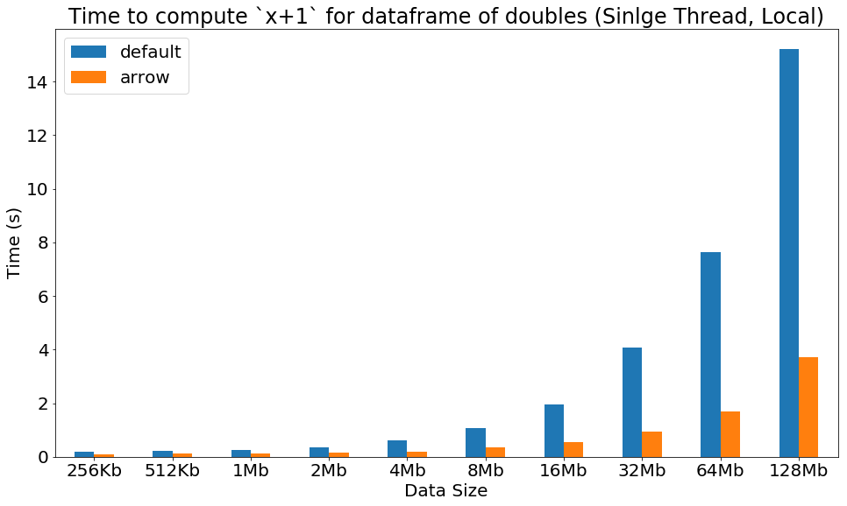
Scalar vs Vectorized UDF
4.5x Speed Up

Slide 35
Support Group UDF
Split-apply-combine:
Break a problem into smaller pieces
Operate on each piece independently
Put all pieces back together
Common pattern supported in SQL, Spark, Pandas, R …

Slide 36
Split-Apply-Combine (Current)
Split: groupBy, window, …
Apply: mean, stddev, collect_list, rank …
Combine: Inherently done by Spark

Slide 37
Split-Apply-Combine (with Group UDF)
Split: groupBy, window, …
Apply: UDF
Combine: Inherently done by Spark

Slide 38
Introduce groupBy().apply()
UDF: pd.DataFrame -> pd.DataFrame
Treat each group as a pandas DataFrame
Apply UDF on each group
Assemble as PySpark DataFrame

Slide 39
Introduce groupBy().apply()
Each Group:
pd.DataFrame -> pd.DataFrame
Rows
groupBy
Groups
Groups
Rows
Groups
Groups
Rows
Groups
Groups

Slide 40
Previous Example: Data Normalization
(values – values.mean()) / values.std()
Notes:
Groups are materialized is one of the performance issue. However, this is not the one we focus on here.
For instance, groupBy().agg(collect_list()) fully materialized the group. It takes about 1.5 seconds to do that, while the normalization examples takes more than 25 seconds

Slide 41
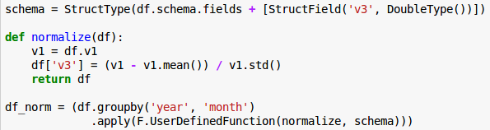
Previous Example: Data Normalization
Current:
Group UDF:
5x Speed Up
Notes:
Make it clear before and after

Slide 42
Limitations
Requires Spark Row <-> Arrow RecordBatch conversion
Incompatible memory layout (row vs column)
(groupBy) No local aggregation
Difficult due to how PySpark works. See https://issues.apache.org/jira/browse/SPARK-10915

Slide 43
Future Roadmap

Slide 44
What’s Next (Arrow)
Arrow RPC/REST
Arrow IPC
Apache {Spark, Drill, Kudu} to Arrow Integration
Faster UDFs, Storage interfaces
Notes:
Less time on this slide
RPC: Generic way to exchange data.
IPC: Share memory
Integration:

Slide 45
What’s Next (PySpark UDF)
Continue working on SPARK-20396
Support Pandas UDF with more PySpark functions:
groupBy().agg()
window

Slide 46
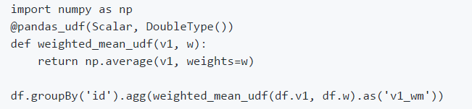
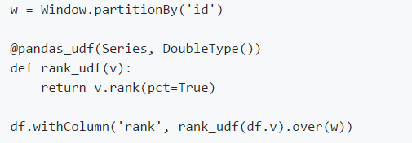
What’s Next (PySpark UDF)

Slide 47
Get Involved
Watch SPARK-20396
Join the Arrow community
dev@arrow.apache.org
Slack:
https://apachearrowslackin.herokuapp.com/
http://arrow.apache.org
Follow @ApacheArrow

Slide 48
Thank you
Bryan Cutler (IBM), Wes McKinney (Two Sigma Investments) for helping build this feature
Apache Arrow community
Spark Summit organizers
Two Sigma and Dremio for supporting this work

